Slide 1
Predictive Analytics in Retail
The Impact of Data Analysis and Predictive Analytics on the Performance and Growth of Retail Stores
Abeer Kareem

Slide 2
Project Overview
Dissertation: MSc in Computer Science with Data Science
Goal: Demonstrate how predictive analytics enhances retail performance
Solution: Developed a modular analytics artefact with ML, DL, and clustering models

Slide 3
Data Preparation
Datasets: Retail Transactions, Sales, Inventory, Customers
Cleaned nulls, encoded categories, scaled features
Engineered RFM metrics and product diversity
Resampled time-series data and applied PCA

Slide 4
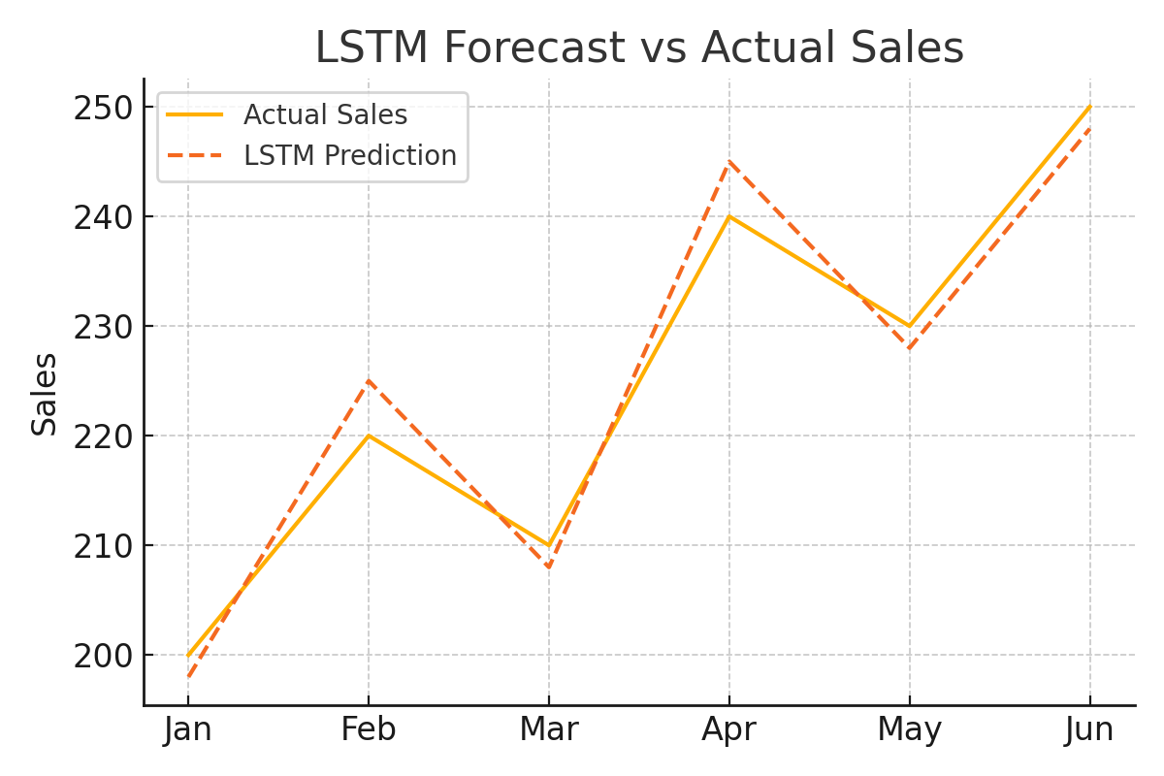
Sales Forecasting with LSTM & Prophet
LSTM RMSE = 1.84 (accurate for seasonal trends)
Prophet MAE = 2.21 (interpretable forecasts)
Tools: TensorFlow/Keras & Prophet
Guided stock planning around sales peaks

Slide 5
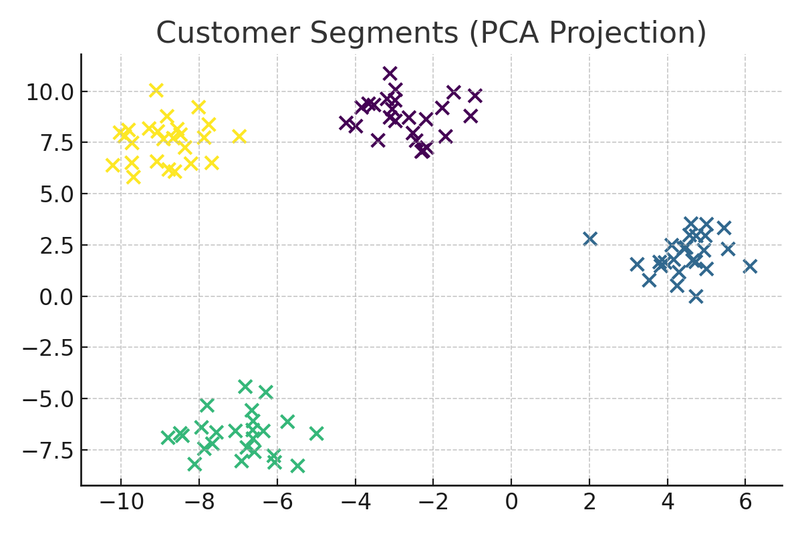
Customer Segmentation with RFM & Clustering
Used RFM scores with K-Means, DBSCAN, Hierarchical
Identified High-Value, At-Risk, Frequent segments
Silhouette Score: 0.61
Enabled targeted campaigns

Slide 6
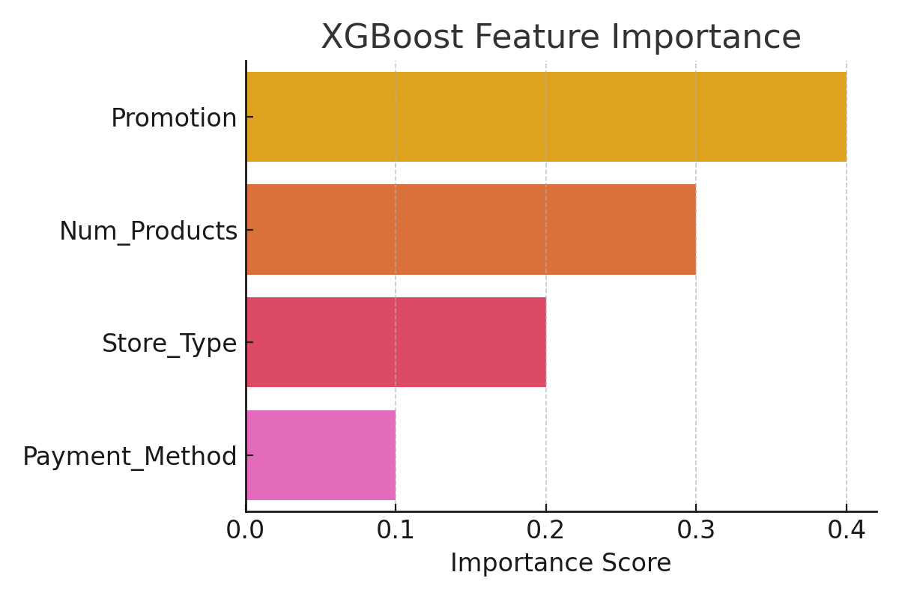
Inventory Forecasting using XGBoost
Model: XGBoost Regression (R² = 0.87)
Features: Item Type, Supplier, Retail Transfers
Output: Forecasted stock needs, reduced waste
Informed procurement and logistics

Slide 7
Tools Used in the Research
Programming Languages: Python (main analysis), SQL (data extraction)
Machine Learning Libraries:
TensorFlow / Keras – LSTM forecasting
XGBoost – Regression for inventory prediction
Scikit-learn – Preprocessing, clustering, evaluation
Time Series & Forecasting Tools:
Facebook Prophet – Trend forecasting and seasonality analysis
Visualisation Tools:
Matplotlib, Seaborn , Plotly– Data exploration and charts
Plotly – Interactive dashboards
PCA plots, confusion matrices from Scikit-learn
Methodology Framework:
CRISP-DM – Structured analytics workflow
Data Sources:
Open-source retail datasets (sales, inventory, customers)

Slide 8

Impact & Business Outcomes
Improved forecast accuracy and planning
Delivered customer insights for marketing
Optimised stock replenishment
Created flexible system for SMEs

Slide 9
Conclusion & Future Enhancements
Predictive analytics enhances agility and decision-making in retail
Future work: real-time analytics (Kafka), ethical AI (SHAP, LIME), Streamlit dashboards (Power BI)
Apply it in other area

Slide 10
Thank you for your attention. I welcome your questions
Q&A

